Slide 1
Coffee Beans Sales and Inventory Analysis & Recommendations
CECS 551: Advanced Artificial Intelligence
Supervisor
Professor Mahshid Fardadi
Dr. Allen Bolourich

Slide 2
Report outline
Introduction: Coffee Beans
Understanding dataset
Designing a sales prediction model
Investigation and recommendation
Conclusion

Slide 3
Problem Statement
Background
For a growing business which runs hundreds of coffee shops, it is undeniable that these stores will find themselves gradually producing more waste and potentially miss trends to increase sales.
However, manually analyzing inventory patterns to reduce waste and increase sales is a monumental task to take on.
As such, we devised machine learning models trained with a year’s worth of inventory and sales data to approximate how the business may boost sales and reduce waste.
Goal: Optimize inventory to Boost Sales and Reduce Waste.

Slide 4
Proposed Workflow
Phase 1: Understand the data distribution, relationship among them using correlation matrix and SHAPly feature interactions.
Phase 2: Create a predictor for sales of each product based on which we can optimize the restocking and inventory management of stores 18, 117, 332.
Phase 3: Provide insight and recommend initiatives based on the sales predictions modeland provide minimum of three inventory optimization initiatives.

Slide 5
Exploratory Data Analysis
Analyze Inventory Patterns per Product

Slide 6
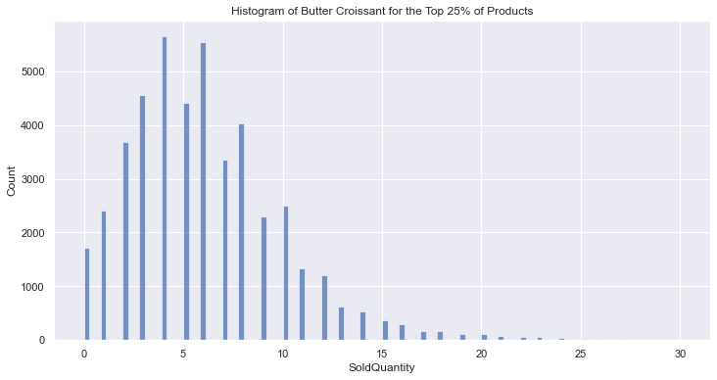
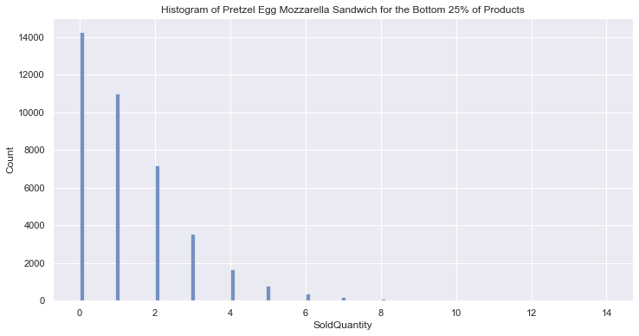
EDA: Analyze Inventory Patterns per Product
Top 3 Products | Products
Best | Butter Croissant, Everything Bagel, Coffee Cake
Worst | Caprese Sandwich, Cookie - Chocolate Chunk, Pretzel Egg Mozzarella Sandwich
Bottom 3 products tend to be retained in stores much more and sell less, costing up to $3.34 more potential waste per store per day.

Slide 7
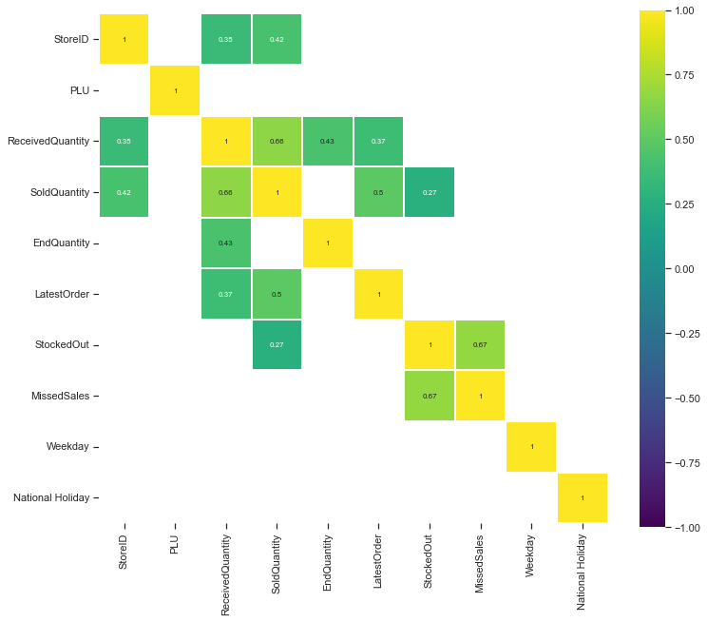
EDA: Feature importance
Correlation matrix

Slide 8
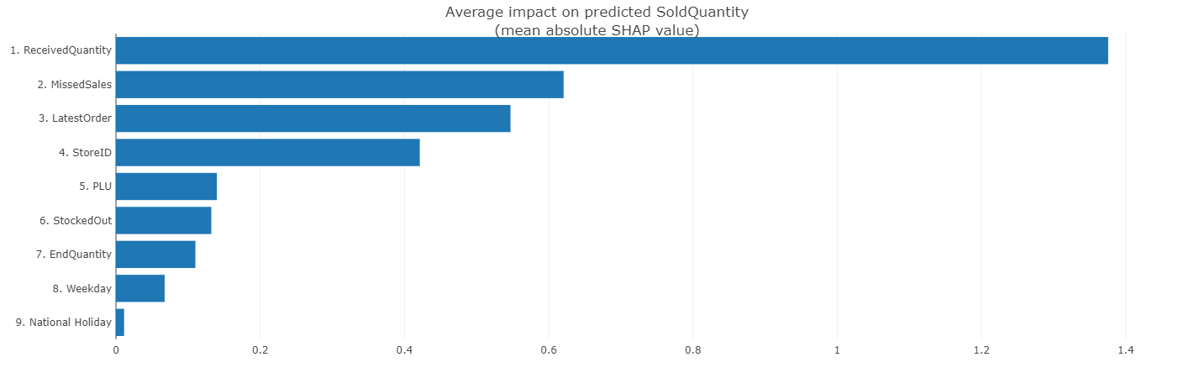
EDA: Feature importance
SHAPly feature ranking

Slide 9
Sales Prediction

Slide 10
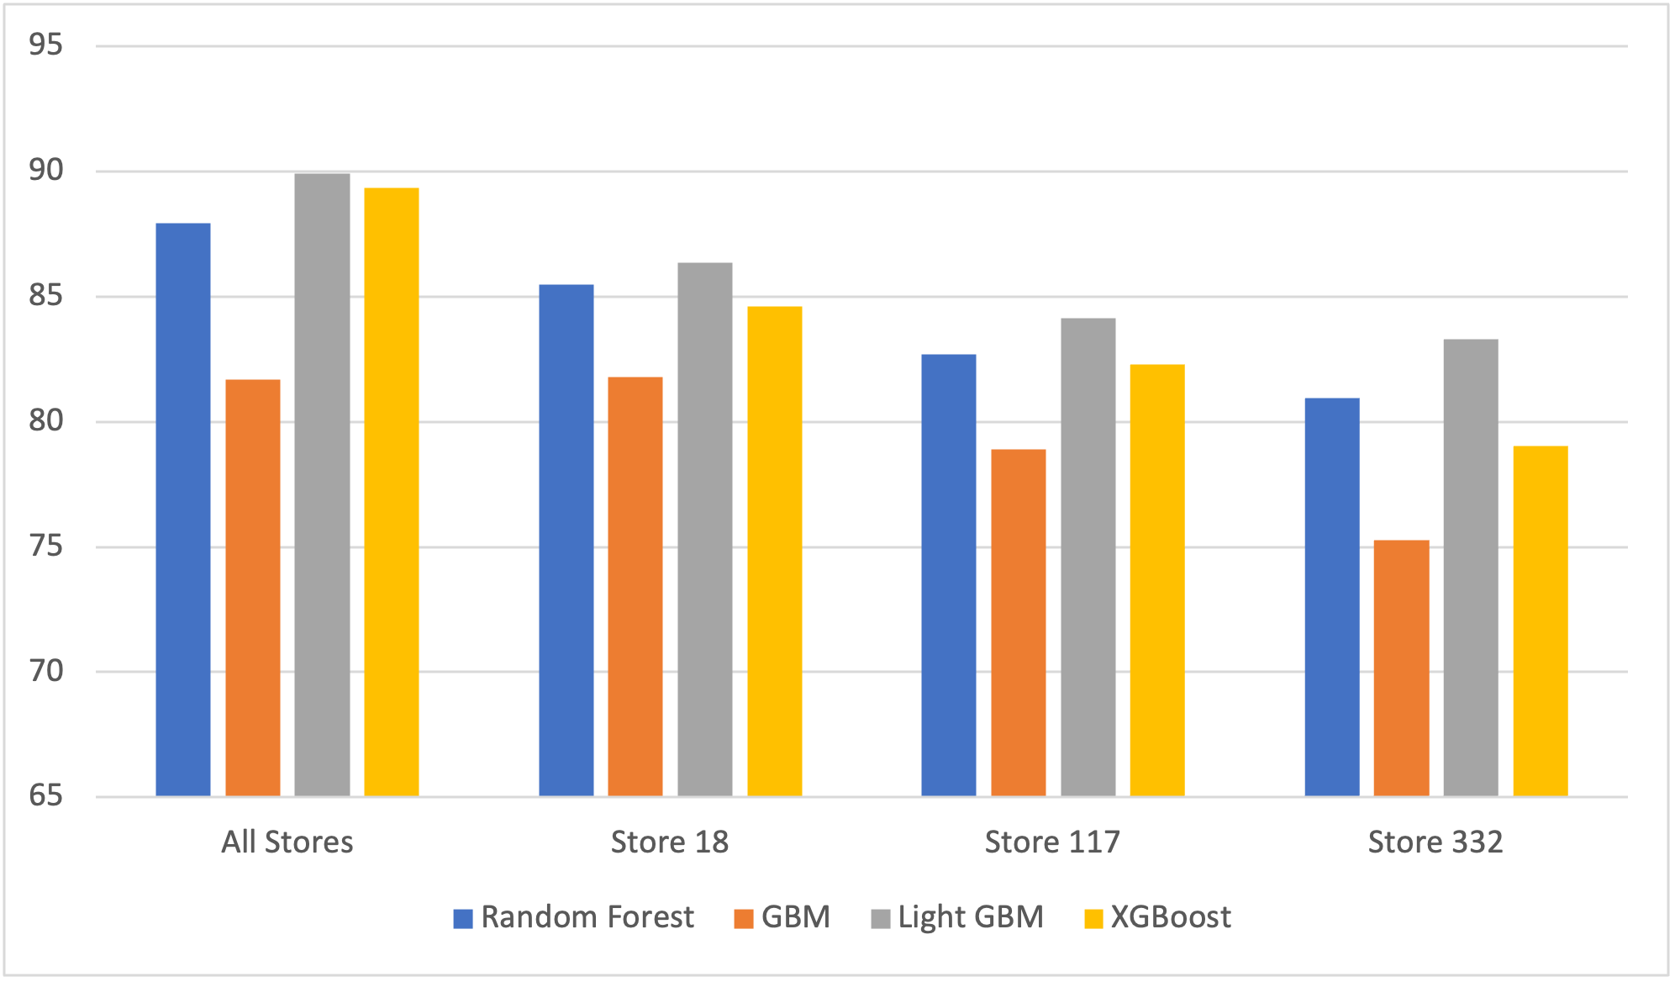
Algorithms
Random Forest
Gradient Boosting Machine
Light GBM
XGBoost
Light GBM and XGboost reported the best accuracies (90%) among all the models

Slide 11
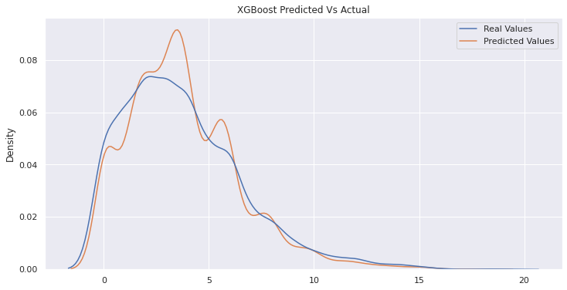
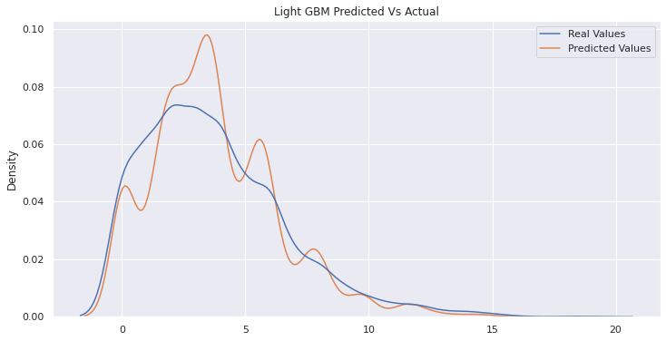
Why choose Light GBM vs XGBoost ?
 | Accuracy | Execution time
Light GBM | 89.90 | 0.22
XGBoost | 89.34 | 12.74
Low memory usage
Parallel processing
Faster training speed

Slide 12
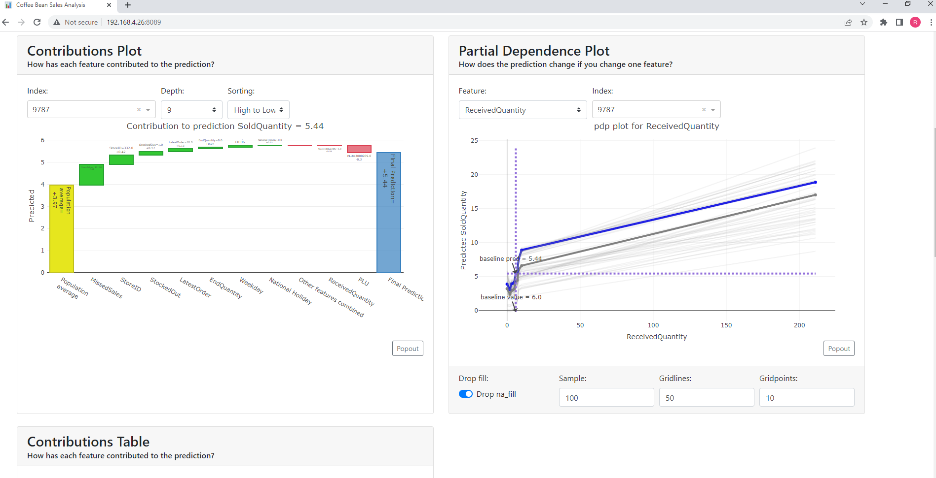
Model deployment

Slide 13
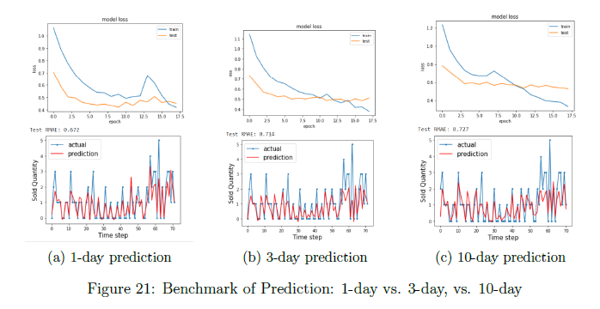
LSTM Time series analysis
Store | 1 day | 3 day | 10 day
18 | 0.9 | 0.98 | 1.04
117 | 0.94 | 0.98 | 1.02
332 | 1.44 | 1.5 | 1.44
Implemented for 1-day, 3-day, 10-day prediction, 1-day predict is more accurate based on week-day and store data.

Slide 14
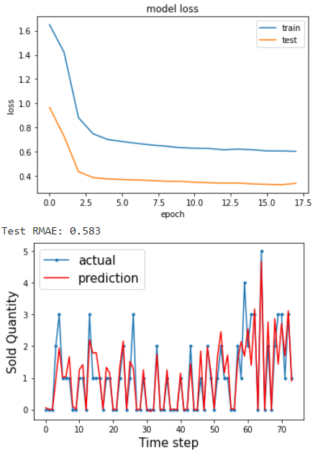
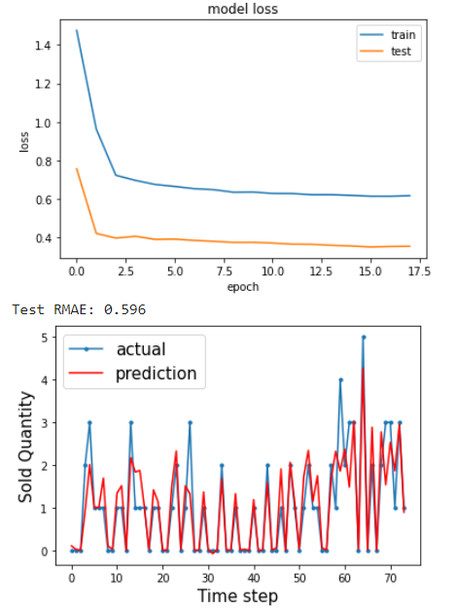
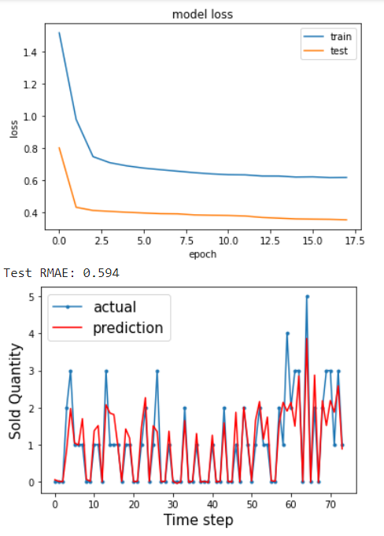
LSTM Time series analysis
Store | 1 day | 3 day | 10 day
18 | 0.88 | 1.2 | 1.72
117 | 0.87 | 1.31 | 1.72
332 | 0.88 | 1.24 | 1.71
Implemented for 1-day, 3-day, 10-day prediction, 1-day predict is more accurate based on weather data.

Slide 15
Inventory Optimization
Proposal of Initiatives to Improve Sales

Slide 16
Initiatives and Caveat
Initiative 01
Increase product Received Quantity during weekends holidays, adjust End Quantity accordingly.
Initiative 02
Correlate products based on temperature (Example: Increase Received Quantity for cold products on warmer weather days).
Initiative 03
Increase all products received quantity by 20%, adjust end quantity accordingly.
Must consider waste cost per initiative as well, with consideration towards product shelf life.

Slide 17
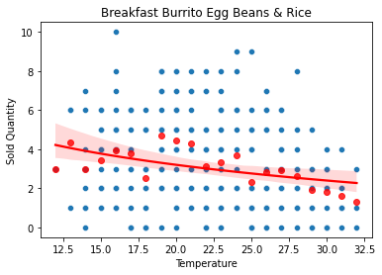
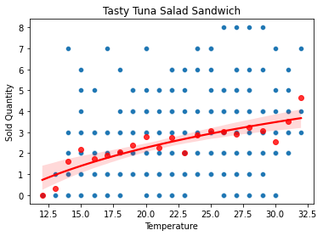
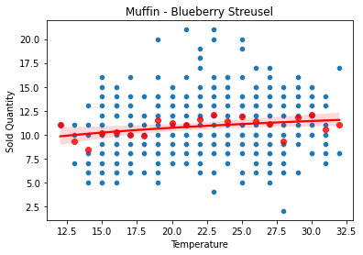
Roadblocks with Initiative 02
Attempt to reduce waste and increase profit by predicting sales based on temperature
Different bestselling items per store
Optimization based on temperature data may not be feasible
Store 332 Store 332 Store 332

Slide 18
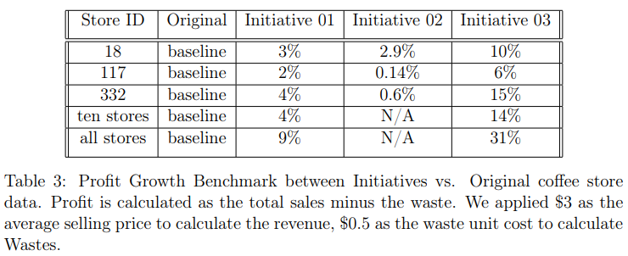
Cost Benefit Analysis: Overview
As a result, we see an overall positive increase on these initiatives, with a noticeable spike towards Initiative 3.
Conservative estimates: LSTM model, however more risk taking predictions tend to result in higher profit at a cost of more waste. This may reflect a potential signal boost to increase our initiative’s effects.

Slide 19
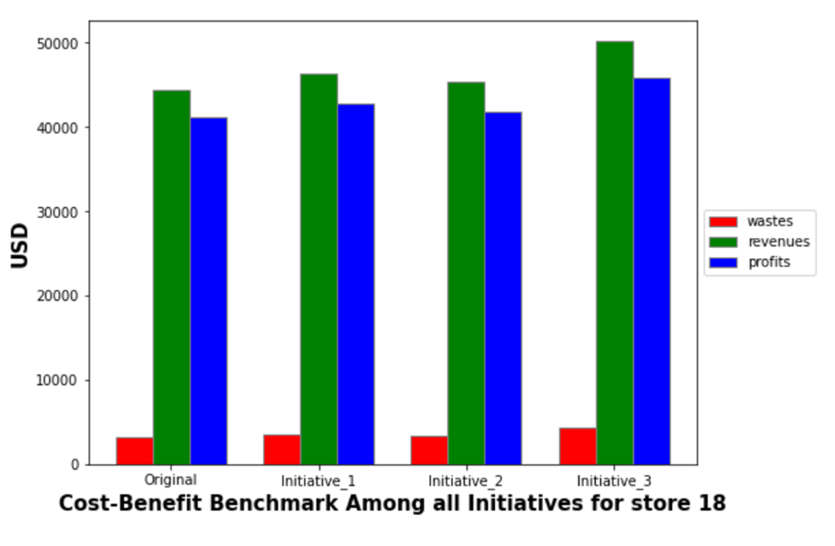
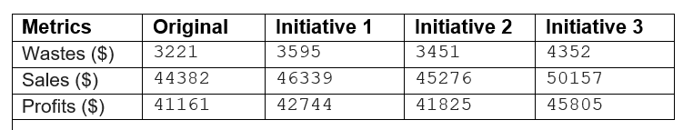
Cost Benefit Analysis: Store 18
initiative 1: profit increases 3%
initiative 2: profit increases 2.9%
initiative 3: profit increases 10%

Slide 20
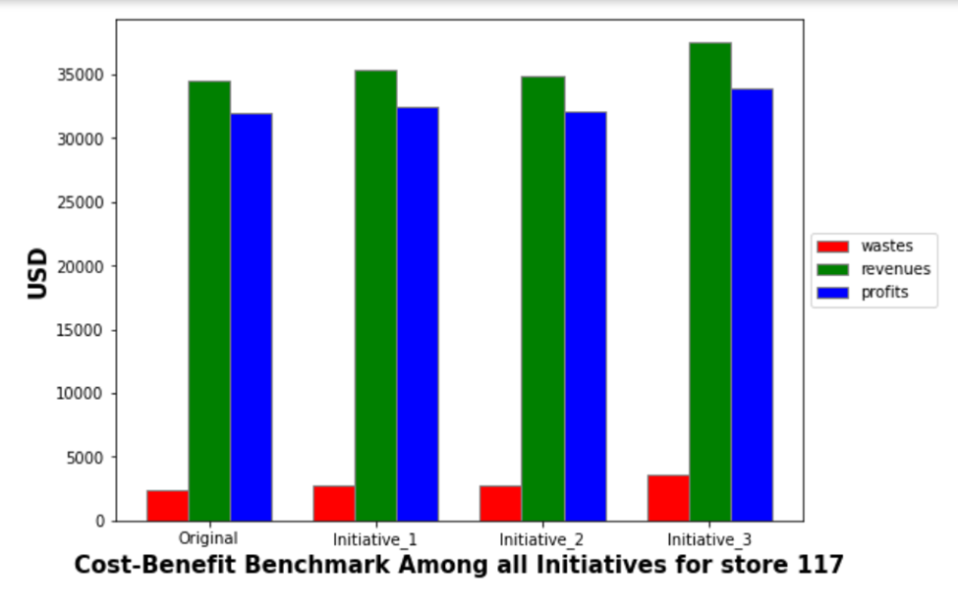
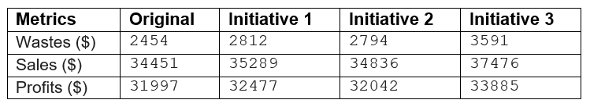
Cost-Benefit Analysis: Store 117
initiative 1: profit increases 2%
initiative 2: profit increases 0.14%
initiative 3: profit increases 6%

Slide 21
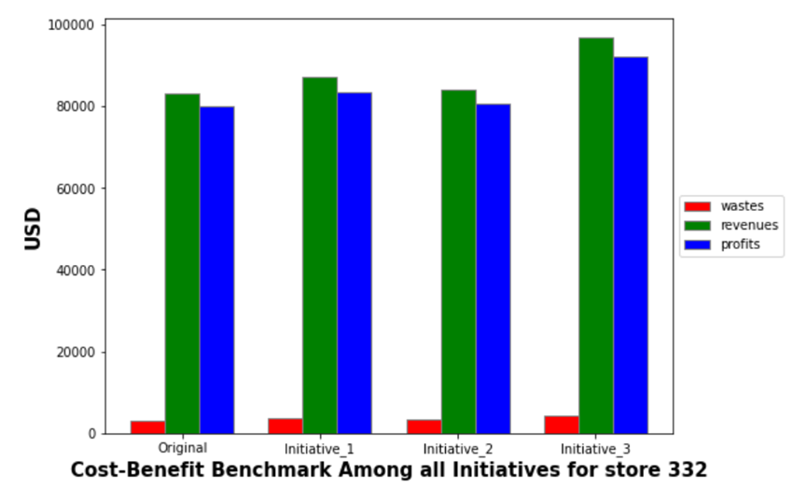
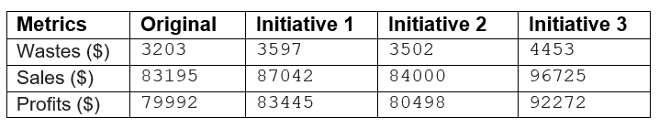
Cost-Benefit Analysis: Store 332
initiative 1: profit increases 4%
initiative 2: profit increases 0.6%
initiative 3: profit increases 15%

Slide 22
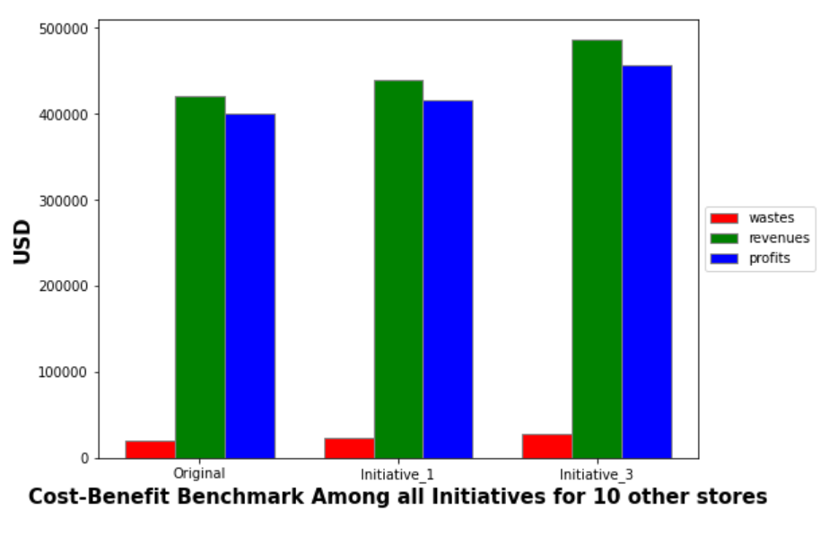
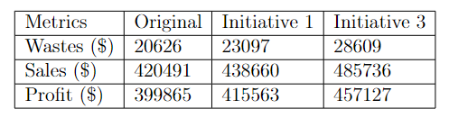
Cost-Benefit Analysis: 10 Other Stores
initiative 1: profit increases 4%
initiative 3: profit increases 14%

Slide 23
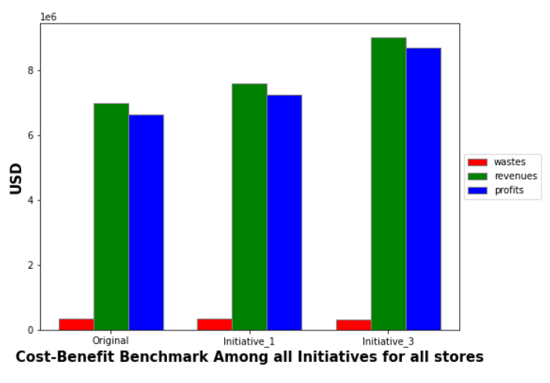
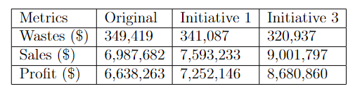
Cost-Benefit Analysis: All Stores
initiative 1: profit increases 9%
initiative 3: profit increases 31%

Slide 24
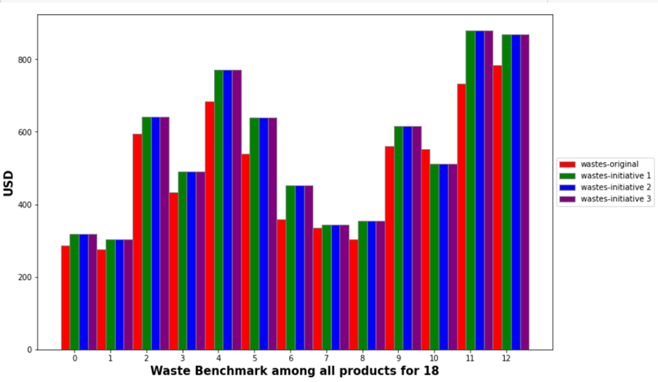
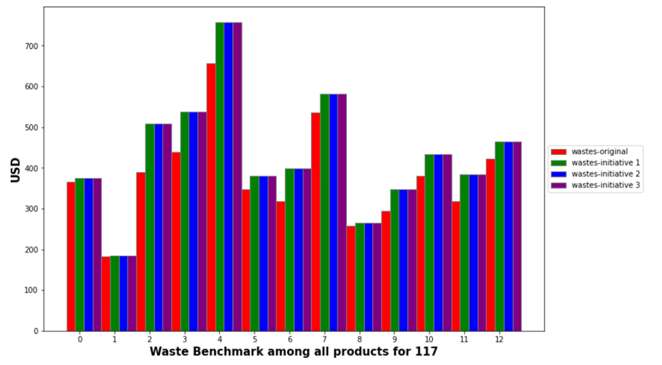
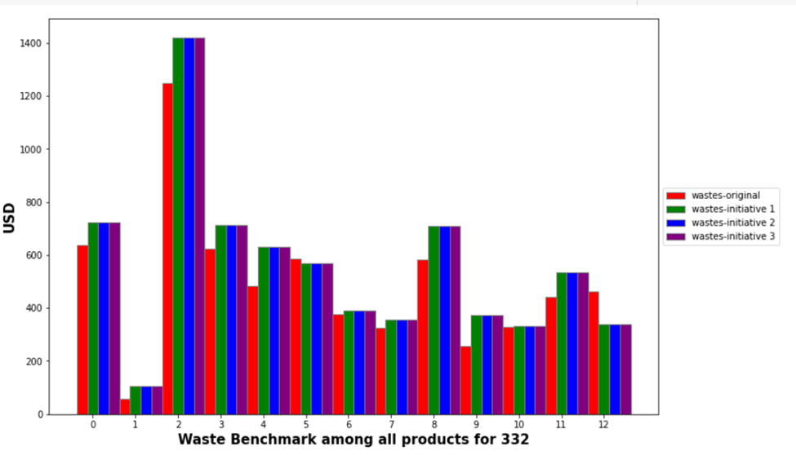
Which products have more wastes? (3 Stores)
Store 18
Store 117
Store 332
4: 'Butter Croissant', 11: 'Coffee Cake with Streusel', 12: 'Almond Croissant’
4: 'Butter Croissant'
2: 'Everything Bagel'

Slide 25
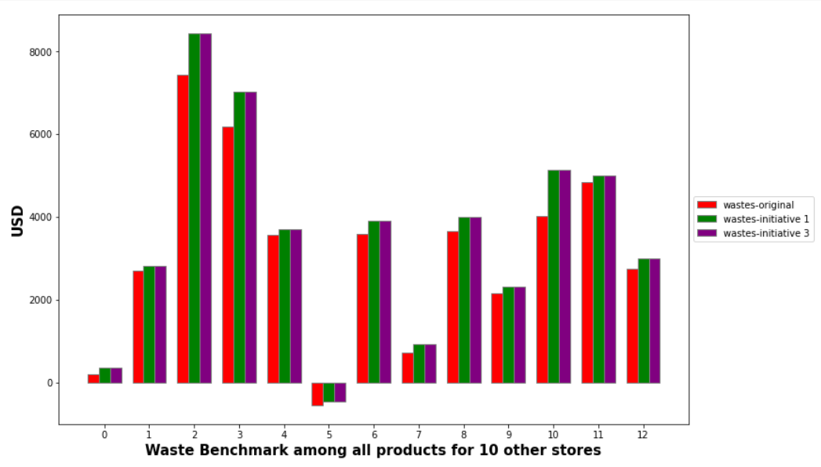
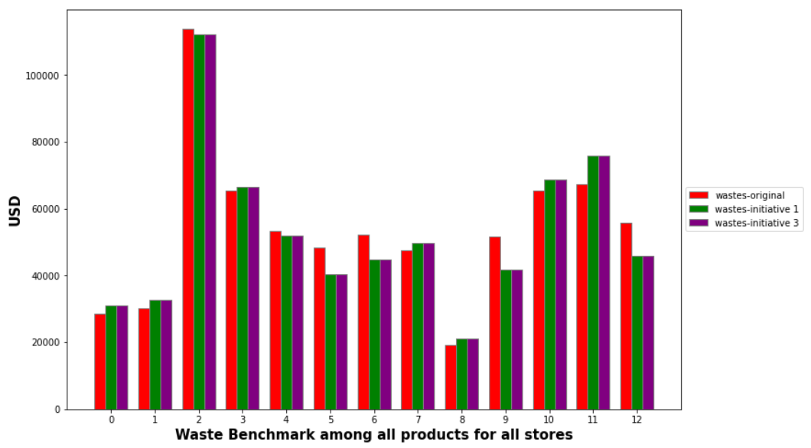
Which products have more wastes?
10 Other Stores
All Stores
2: Everything bagel
3: Blue-berry Scone
2: 'Everything Bagel'

Slide 26
Key Findings
The models are conservative in predicting sales, particularly the peak and low changes.
Due to the conservative nature of the model, increasing inventory by a flat rate (e.g. 20% in our initiative 3) drives the model to be closer to the market reality.
Weekend/holiday can be combined with a flat raise to form a new initiative.
Client Implications
Investigate the impact of flat raising of all product stocks, during holidays and weekends, and potentially utilizing weather forecasting as well.

Slide 27
Conclusions
Trend 1
Improved sales during weekends / holidays.
Trend 2
Certain products produce much more waste than others
Trend 3
Weak positive trend towards adjusting stocks according to weather.
Client Implication
Increasing stocks during weekends / holidays bears investigation.
Client Implications
Reduce the stocks of those products to help the business’s bottom line.
Client Implications
Requires further investigation, dynamically adjust stocks based on weather forecast.

